Slide 1
First Holy Communion Parents Session 1 Baptism
Fr Daniel Daley
Notes:
Welcome to this first parent's session, where our focus will be BAPTISM.

Slide 2
The aim of this session
To help us understand why we need to baptised.
The remind ourselves how we are to live out the faith we received at our baptism.
Notes:
To help us understand why we need to baptised [and hopefully why you chose to baptise your children!]
The remind ourselves how we are to live out the faith we received at our baptism [and so help you to continue to help your children grow in their love of Jesus Christ]

Slide 3
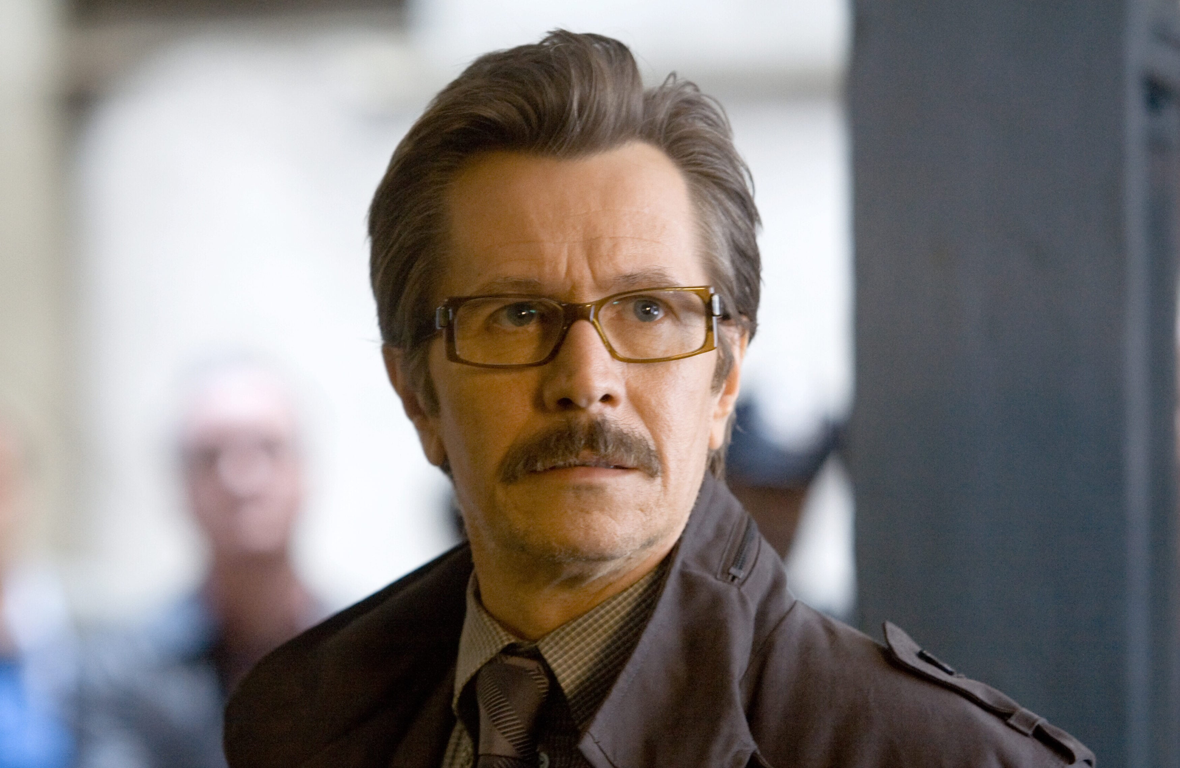
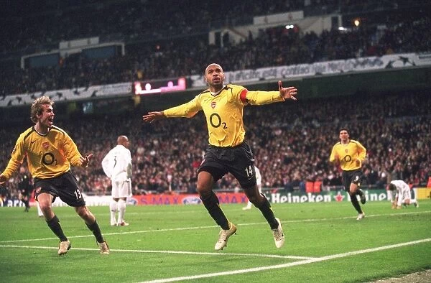
What is your ambition for your child?
Notes:
What is your ambition for your child? For your children?
To be a famous actor (Gary Oldman)
To be world famous singer (Taylor Swift)
To be a world class sportsman (Thierry Henry)
To help others (as a nurse or doctor)

Slide 4
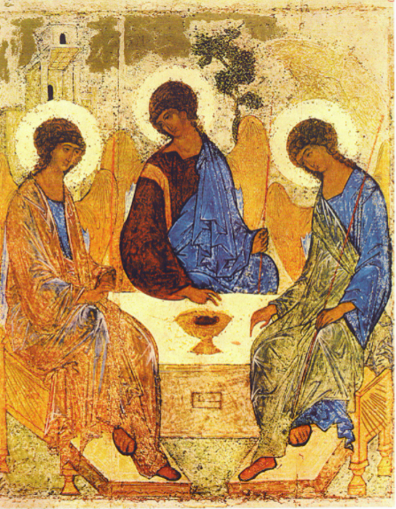
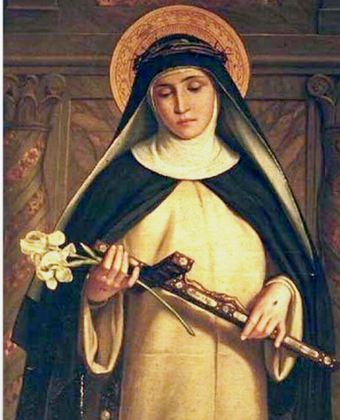
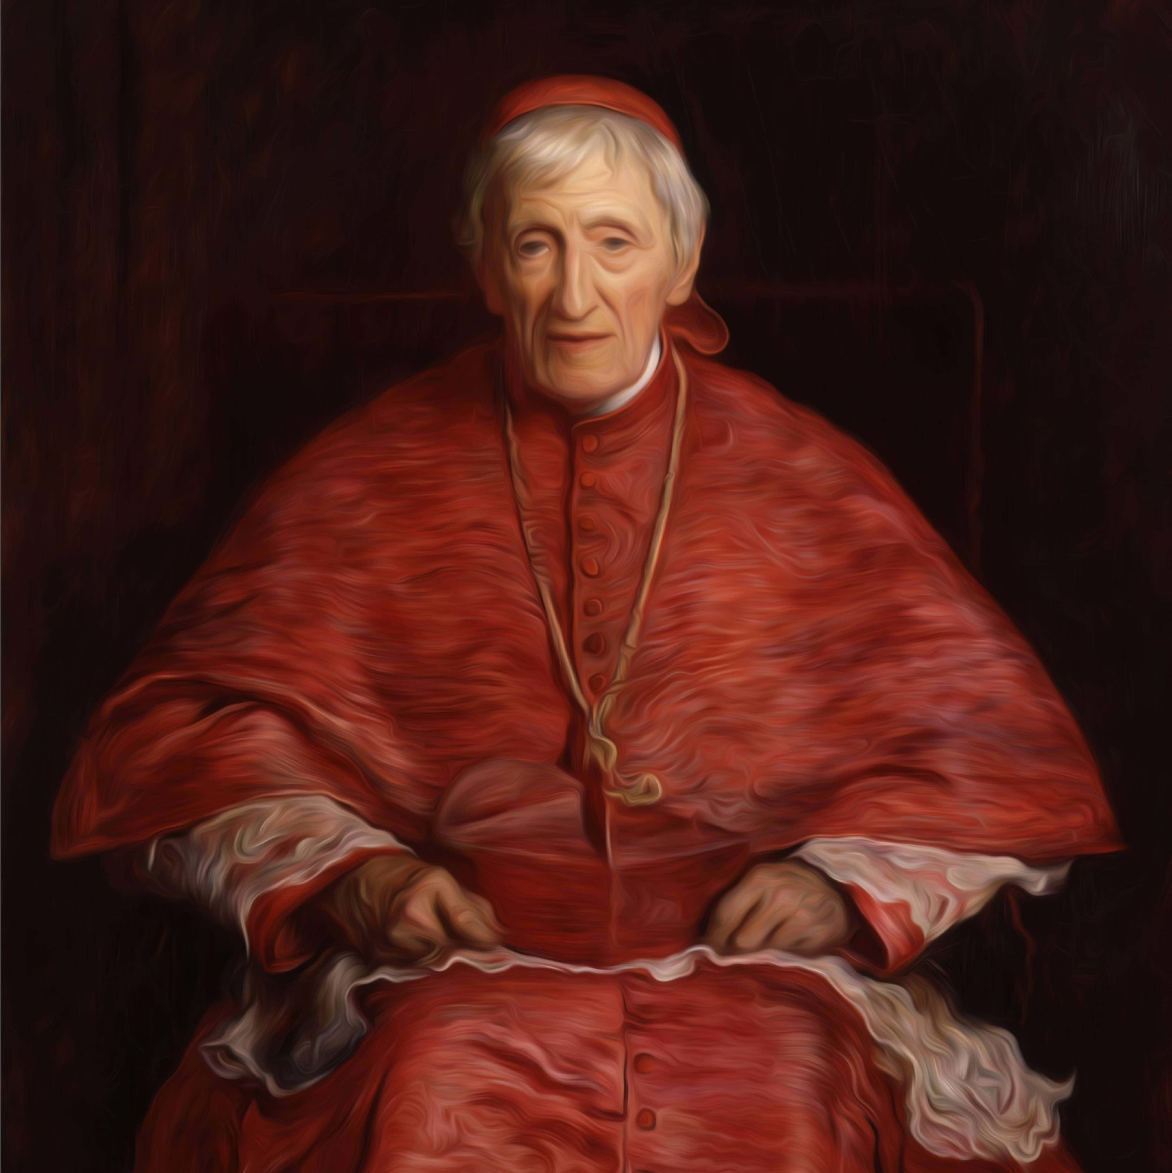
God’s Ambition for US is that we are holy!
Notes:
God’s ambition for each of us, the baptised, is that we are HOLY, that we become SAINTS, so that we can share in his divine life, so that we can join him in heaven.
Like Catherine of Siena
Like John Henry Newman
We are invited to take our place at the table, to take our place in the Trinity.

Slide 5
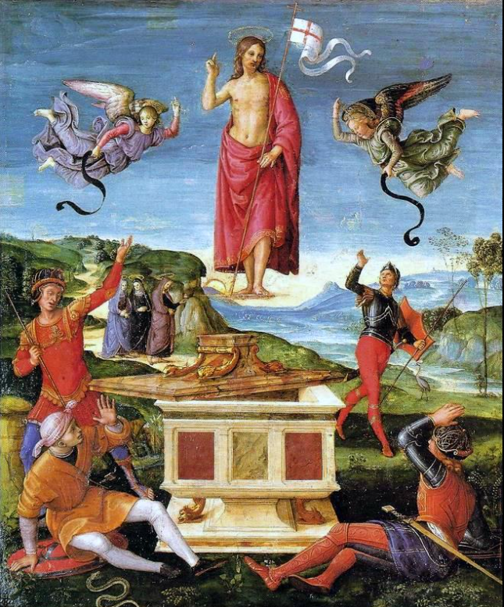
Faith and baptism
The starting point for baptism is belief in Jesus Christ.
That is Jesus the SON OF GOD.
Jesus both fully HUMAN and fully DIVINE.
Without this faith in Jesus Baptism makes no sense!
“The faith required for Baptism is NOT a perfect and mature faith, but a beginning that is called to develop.” CCC 1253
Notes:
The Catechism goes on to say that “for all the baptised, children or adults, faith must grow after Baptism. For this reason the Church celebrates each year at the Easter Vigil the renewal of baptismal promises.” CCC 1254
As Cardinal Basil Hume would say, “we are pilgrims of a journey towards perfection…”

Slide 6
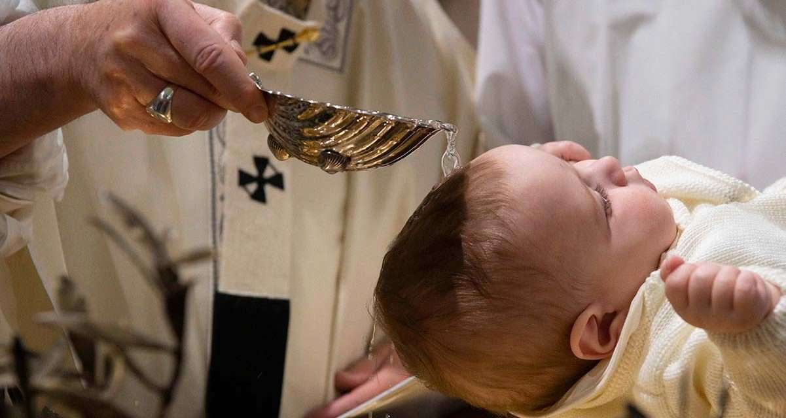
Baptised is salvation
Salvation is the GOAL OF BAPTISM!
Salvation is about ‘how’ we get to heaven.
Salvation is about us coming to share God’s life with him.
Ultimately salvation is about us coming to participate in God’s own life.
Baptism is the way out of the kingdom of death into life, the GATEWAY to the Church, and the beginning of a lasting COMMUNION WITH GOD. [YouCat 194]
Salvation = sharing in God’s Trinitarian life!
Notes:
Salvation = sharing in God’s Trinitarian Life.
Just consider how you integrated your children into your wider family and friends, mainly I suspect through interaction, going to see them, spending time with them, talking and listing to them, participating in their lives in some way.

Slide 7
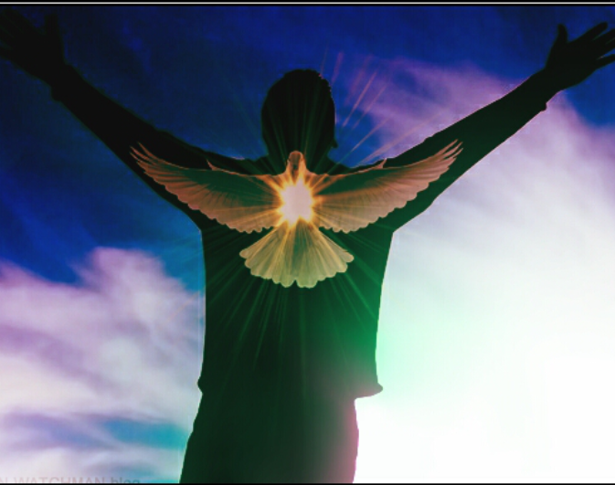
Salvation is participation
“His divine power has granted to us all things that pertain to life and godliness…that through these [we] may escape from the corruption that is in the world…and become partakers of the divine nature.” “ Peter 1: 3 – 4
The difference between us and God is infinite!
However:
When we receive the Holy Spirit at Baptism, we are able to participate in God’s own life.
The infinite gap between us and God is bridged, and we have the capacity to KNOW God personally.
The indwelling of the Holy Spirit

Slide 8
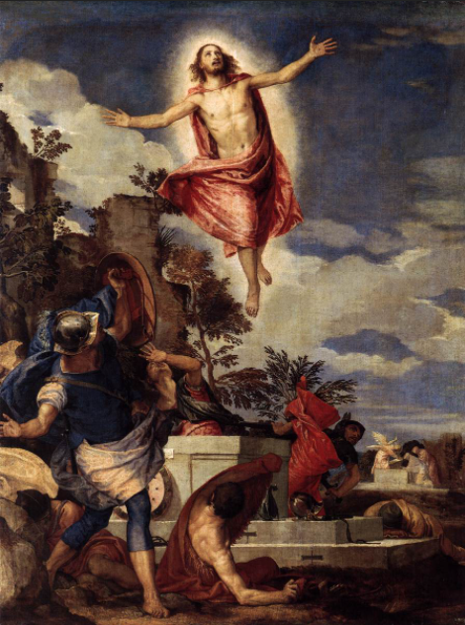
SALVATION IS TRANSFORMATION
“Beloved, we are god’s children now; it does not yet appear what we shall be, but we know that when he appears we shall be like him, for we shall see him as he is.” 1 John 3:2
This participation in God’s life has the effect of causing a real change in us: A TRANSFORMATION.
Let’s listen to the Church Fathers:
St Athanasius “God became man that man might become God…”
St Cyprian “for [salvation] is to change what you had been, and begin to be what you were not, that is, the sons of god by grace, that the divine birth might shine forth in you.”

Slide 9
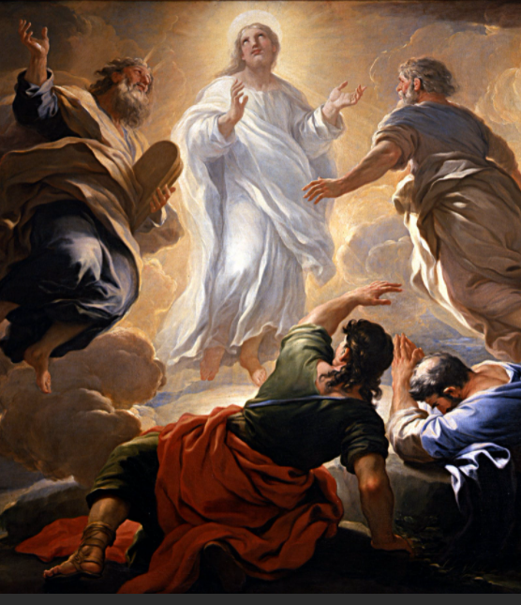
Participation is transformation
When we receive the HOLY SPIRIT at Baptism, we receive the potential to radically change who we are, by:
Being able to know God intimately
Being able to act like God in this world
In fact, Salvation is about becoming ANOTHER CHRIST
“I have been crucified with Christ; it is no longer I who live, but Christ who lives in me…” St Paul’s letter to the Galatians 2:21
The transfiguration gives us a glimpse at what is to come.
Notes:
Salvation is about receiving the Holy Spirit from Christ, so as to be transformed into Christ, coming to Love and Know the Father as he does.

Slide 10
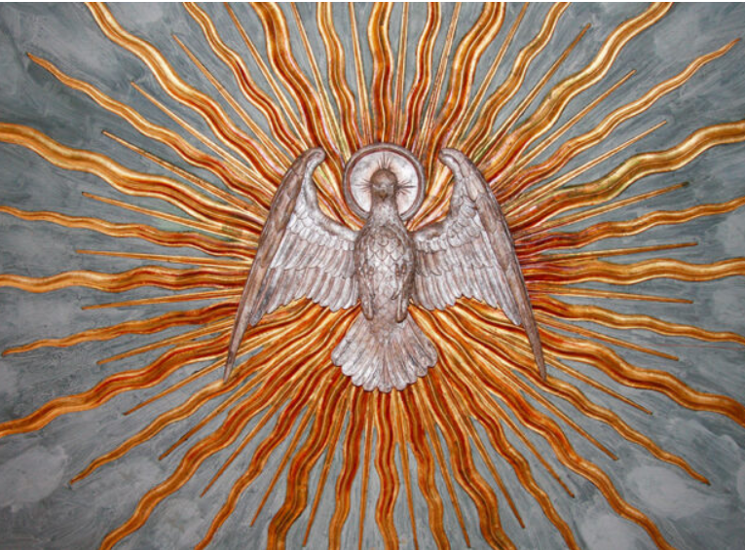
The HOLY SPIRIT
Salvation is about receiving the Holy Spirit from Christ.
The Holy Spirit helps to transform us into Christ.
The Holy Spirit is the POWERHOUSE OF SALVATION
This was a great promise in the Old Testament:
“And I will put my spirit in you, and cause you to walk in my statutes and be careful to observe my ordinances…and you shall be my people, and I will be your God.” Ezekiel 36: 27 – 28
Notes:
Participation is Transformation
Salvation is Transformation into Christ
When your child received the Holy Spirit at Baptism, they received the potential to radically change who they would become by:
Being able to know God intimately
Being able to love God in this world
Being able to act like God in this world.
In fact, Salvation is about becoming another Christ.

Slide 11
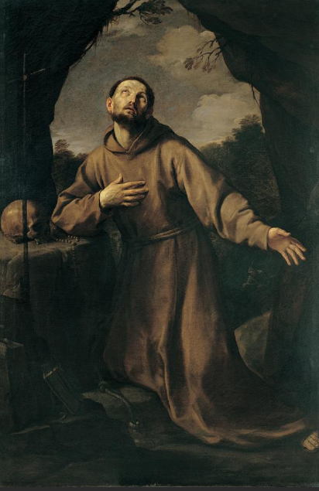
Transformation by growth
“Blessed are the pure in heart, for they shall see God.” Matthew 5:8
The Key to the Christian Life:
The divine life we receive at Baptism is like a seed.
This seed will grow when we water it with:
Good works
Prayer
The Sacraments (the channels of God’s grace)
Good works, prayer and the sacraments deepen our participation in God’s life.
“Start by doing what is necessary, then what is possible, and suddenly you are doing the impossible!”
St Francis of Assisi
Notes:
From what I have seen so far you are already doing this, your children are well versed in prayer, they want to do good, and you are seeking out the sacraments for them to participate more fully in the life of Christ [even the ones who don’t always clean their rooms when you ask!]

Slide 12
Living out our baptism
Being a Christian is not easy!
This why at your child’s baptism you, as their parents, PROMISED to:
To take responsibility of for training your children in the practice of the faith.
By bringing them up to keep God’s commandments as Christ taught us.
By loving God and our neighbour as ourselves.
“For the grace of Baptism to unfold, the parents’ help is important. So too is the role of the godfather and godmother, who must be firm believers, able and ready to help the newly baptised…on the road of Christian life.” CCC 1255
Notes:
Your example is critical to your child’s development in their faith, and this remains true not just for this year of First Holy Communion but throughout their lives.
For instance, if your priority on a Sunday is going to big football or rugby match rather than going to Mass, then this will be the same for child. If you make no time to pray with you children at home, then they will not make any time to pray in their lives.

Slide 13
Helping the seed of faith to grow
Notes:
Your example is critical to your child’s development in their faith, and this remains true not just for this year of First Holy Communion but throughout their lives.
For instance, if your priority on a Sunday is going to big football or rugby match rather than going to Mass, then this will be the same for child. If you make no time to pray with you children at home, then they will not make any time to pray in their lives.
My mother raised me and my brother in the faith, she taught us to pray, read bible stories to us in the evening and took us to Mass every Sunday. She tried to live out her faith in work as teacher, standing up for the most vulnerable and encouraging all her students to be the best they could be. She help me and my brother understand the talents and gifts God had given us and to direct them towards do his will.
Your children have a variety of different and wonderful talents, part of the joy of parenthood is helping them understand what these talents are, developing them and using them to build up God’s Kingdom on Earth. Being a great actor, or a talented singer, a wonderful footballer, a doctor or a nurse, none of these prevent us from becoming Holy, unless we allow them to become the centre of lives, taking the place of Jesus Christ.

Slide 14
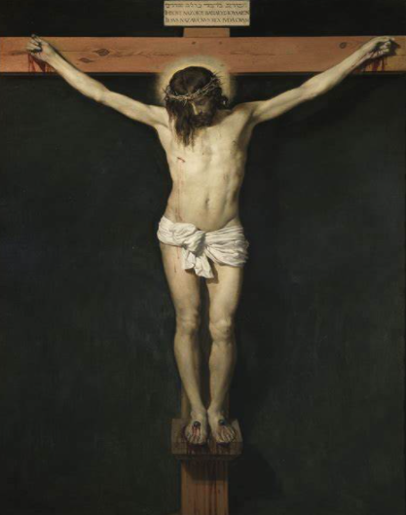
Our end is happiness
What we are made for
St Augustine of Hippo famously said:
“You have made us for yourself, O Lord, and our hearts are restless until they rest in YOU.”
Our happiness is found in God!
At Baptism, when we receive the Holy Spirit, this is the beginning of the pathway to happiness for us.
In agony on the cross, was the happiest man in the world, for the sins of the world failed to hold back his love!
Notes:
As I have said in the confessional numerous times, our God does not call us to be miserable! God wants us to be happy.
This is not a passing feeling or a moment of enjoyment.
God wants to be fulfilled to be completely HAPPY in him, in the divine life.
This is what we are made for!
Baptism is the beginning of this wonderful journey back to our God.

Slide 15
Baptism is essential
Overview
Jesus came to forgive us our sins and to give us the Holy Spirit.
We receive the Holy Spirit from Christ at Baptism.
The Holy Spirit helps us to participate in God’s own life.
This participation, it transform us the more we deepen it through good works and prayer.
True happiness is found in living this life with God.
“And Peter said to them, ‘Repent, and be baptized every one of you in the name of Jesus Christ for the forgiveness of your sins; and you shall receive the gift of the Holy Spirit.” Acts 2:37
Notes:
Continue to help your children to participate in the life of Christ, by talking to him in prayer, listening to him in the scripture, being present with them at Mass and by following Jesus’ example in the world.
The promises you made at baptism to raise your children in the faith do not stop now!
They will continue to need your help as they learn what it means be and live as a Christian.
You have done great work so far, thank for you for keeping the promises you made to God for your children at their baptism. Keep going! Continue to ask God for the grace you need and to help your children prepare for this next step in their journey towards life in the Trinity, life with their God.

Slide 16
Things to keep in mind going forward
There are only 8 teaching sessions so if your child misses just 2 then they have missed a quarter of the teaching sessions!
Make sure they have their materials for the classes, namely their books. Those who have not yet come to Parish Office to collect your packs please do so as soon as you are able, our office hours are 9am – 4pm Monday to Friday. If you wish to come outside these hours, please contact me to arrange this.
We also need to see your child’s baptism certificate BEFORE they can be put forward for the sacraments of the Reconciliation and the Eucharist. There are 14 children whose baptism certificates still need to be brought to the parish office. Please deal with this earlier than later.

Slide 17
questions?

