Slide 1
FHC Parents Session 2: Reconciliation
Fr Daniel Daley
Notes:
Welcome to this second parent’s session of Confession
As part for your Children’s FHC programme they will be making their FIRST CONFESSION
This session is designed to explain CONFESSION in more details so that you can help your children participate in this wonderful sacrament.

Slide 2

Why now?
As you have all probably become aware, your children now know the difference between right and wrong.
In Church language we would say they have reached the age of REASON.
Now is the perfect time to begin to learn how to say SORRY when they do wrong AND also to begin to learn how to make AMENDS, to put things right.
This is the basic premise of CONFESSION: Saying SORRY to GOD and putting right what we have done wrong.

Slide 3
The first gift of the Resurrection…
“Jesus said to them again, ‘Peace be with you. As the Father has sent me, even so I send you.
And when he had said this, he breathed on them, and said to them, ‘Receive the Holy Spirit. If you forgive the sins of any they are forgiven; if you retain the sins of any, they are retained.”
Gospel of John 20: 21-23
Notes:
Known as THE POWER OF THE KEYS
No man can forgive sins unless he has a commission from God to do so – the bishop as the successor to the apostles has this and turns delegates this to his helpers the PRIESTS
So it is fitting that the first gift of the RESURRECTION, of new life, is the power to forgive sins, to help sinners move from the path of death to the path of eternal life.

Slide 4
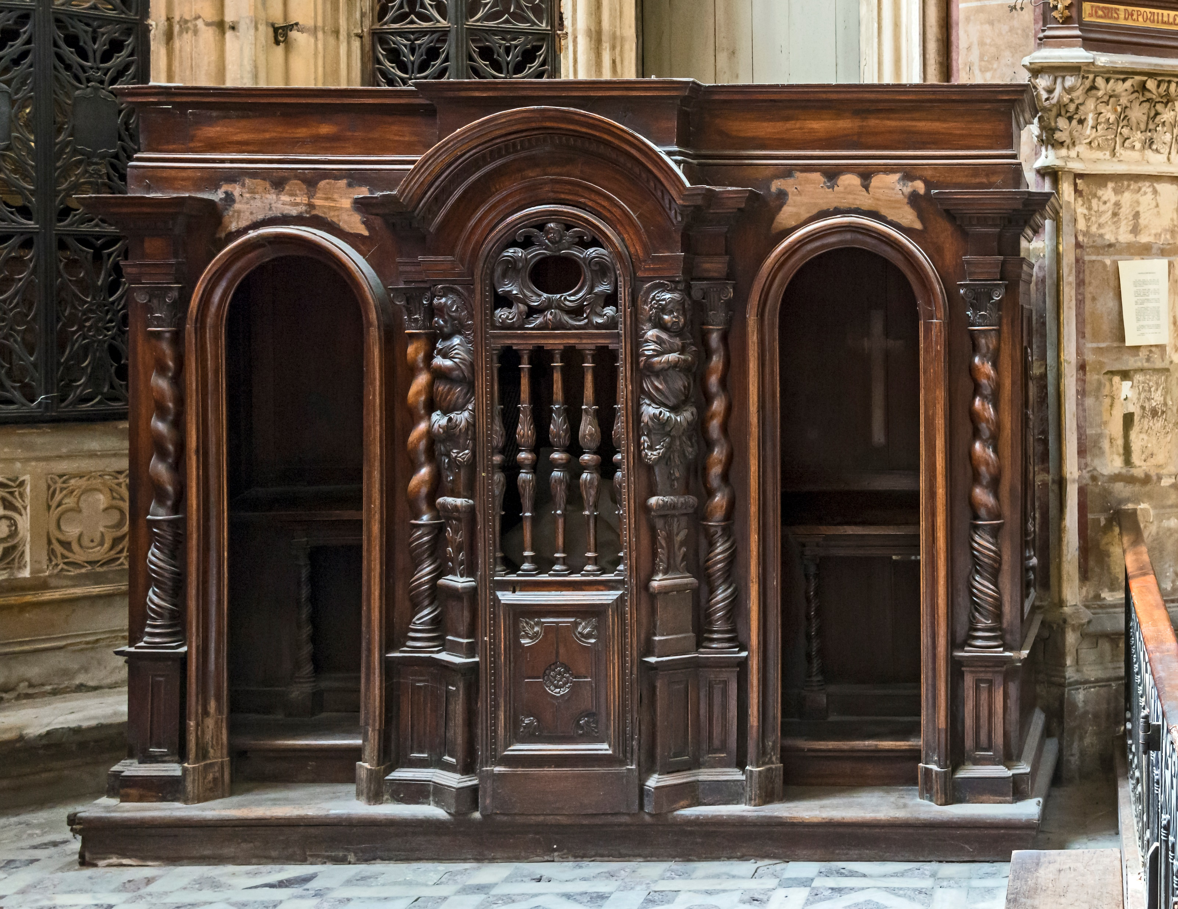
What is the sacrament of Reconciliation?
Reconciliation (or Penance or Confession) is where we come to TELL God our SINS
We express our SORROW for what we have done
We receive GODS FORGIVENESS.
We learn how to MAKE THINGS RIGHT
It is where we come to experience God’s LOVE and MERCY
Notes:
There is a lot of fear and apprehension about confession. For many Catholics there is a miss-understanding about what confession is or they had one bad experience in confession has put them off.
I was once given a stern telling off by a priest in confession, I was only a teenager at the time, and I am reasonably sure what I had done was not that bad, but that experience did put me off returning to confession for a long time.

Slide 5
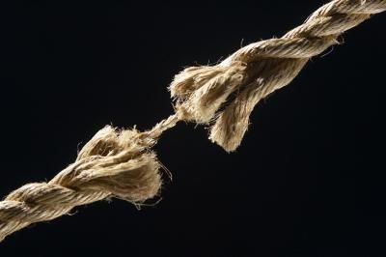
Breaking of our bonds with God
Notes:
Sin breaks our bond, our connection with God.
The Good News is that these breaks can be repaired, can be healed, through the Sacrament of CONFESSION!

Slide 6
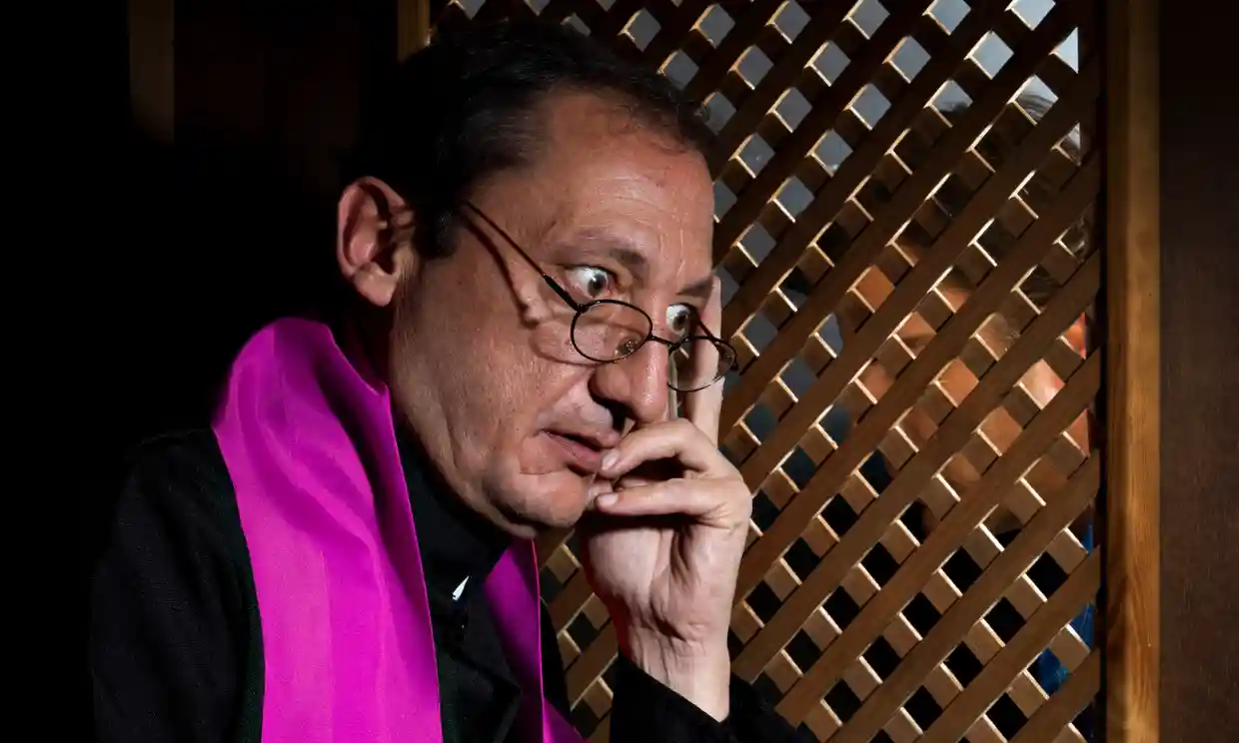
What is this SIN you speak of?
Yes, it is doing something BAD
but more importantly…
…sin is an offence AGAINST God.
A rupture of our COMMUNION with God.
Which at the same time, DAMAGES our relationship with OTHERS.
Notes:
SIN is not a popular word these days and yet it is found throughout the scriptures and also in the prayers of the Church.
In the Catechism of the Catholic Church (para 1440) we learn that SIN is more than just being bad, it is a wilful TURNING AWAY from God.
Sin Breaks our relationship with GOD and damages our RELATIONSHIP with those around us.
Priests too are sinners, however in Confession were are IN PERSONA CHRISTI, in the person of Christ,
We are not there to condemn, RATHER we are there to help sinners get back onto the path of holiness, BACK to GOD.

Slide 7
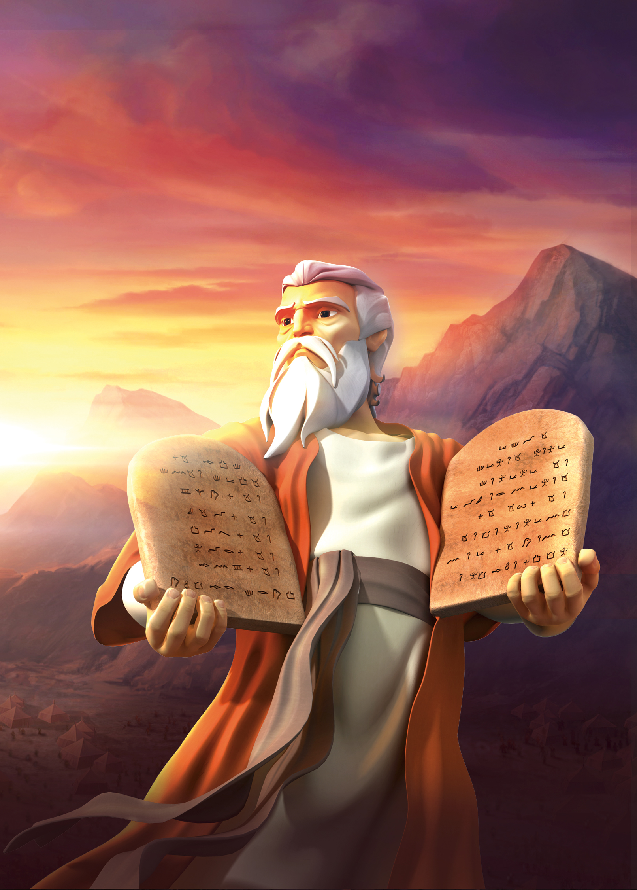
The Ten Commandments / The Decalogue
You shall worship the Lord your God and him only shall you serve.
You shall not take the name of the Lord in vain.
You will keep holy the Sabbath day.
You will honour your father and mother.
You shall not kill.
You shall not commit adultery.
You shall not steal.
You shall not bear false witness against your neighbour.
You shall not covert your neighbour’s wife.
You shall not covert your neighbour's goods.
Notes:
The 10 commandments are a good place to look if we want to begin to understand if we have sinned against God.
Most parents are fans of the FOURTH commandment…strangely this is not always the case with CHILDREN! Yes, children should honour, respect, obey and assist those with legitimate authority over them. However, parents in turn are obliged to educate their children in the faith, to help pray and grow in virtue.
Others that may well apply to your children:
Stealing – I was often lifting the penny sweets from the old Woolworths as a child!
Bearing false witness or lying
Converting your neighbours goods – or wanting what their brother or sister has, or what another child in class has.
All of the above damage or break our relationship not just with GOD but also with our neighbour, our family, our friends, so it is important for you as parents to understand not just WHAT is sinful but why this is so, to help explain this to your children.

Slide 8
Helping your child examine their conscience…
How am I as a child of God?
Do I pray for myself and for others?
Do I take opportunities to help others?
How do I act in my family?
Do I help with family chores?
Have I mistreated my parents and sisters and brothers?
What kind of friend am I?
Do I play fairly and allow other children to share my toys and games?
Do I defend the people that others talk badly about?
Do I have serious faults?
Do I make up stories about others to get them in trouble?
Do I purposely do things that I know my parents would not approve of?

Slide 9
As they grow in understanding
What kind of person am I?
Do I let my anger get the best of me?
Do I take advantage of people?
Do I treat people badly?
Am I only concerned with what I want?
Do I enjoy seeing bad things happen to people?

Slide 10
Why confession?
We relate to God as MEMBERS of the Church and so God’s forgiveness comes to us by means of the Church.
We need assurance that we ARE forgiven, which is what ABSOLUTION from the priest guarantees.
We are notoriously BAD AT JUDGING OURSELVES…the priest brings OBJECTIVITY.
When we recognise and acknowledge our sins this helps FORM A HEALTHY CONSCIENCE.
Confession is one of the most perfect remedies for PRIDE.
Notes:
Sacramental Confession is God’s CHOSEN method for a baptised person to receive forgiveness for serious sin. Why?
We relate to God as MEMBERS of the Church, the Body of Christ, and so God’s forgiveness comes to us by means of the Church.
We need assurance that we ARE forgiven, which is what ABSOLUTION from the priest guarantees.
We are notoriously bad at judging ourselves, either being too lax or too harsh; the priest, acting in the person of Christ, brings a steadying objectivity and helps prevent self-deception.
When we recognise and acknowledge our sins this helps form a healthy conscience, not an unhealthy and debilitating guilt that may cause despair.
Confession is one of the most perfect remedies for PRIDE, the most dangerous of all the sins. By humbling ourselves and asking for forgivensss, God raises us up.

Slide 11
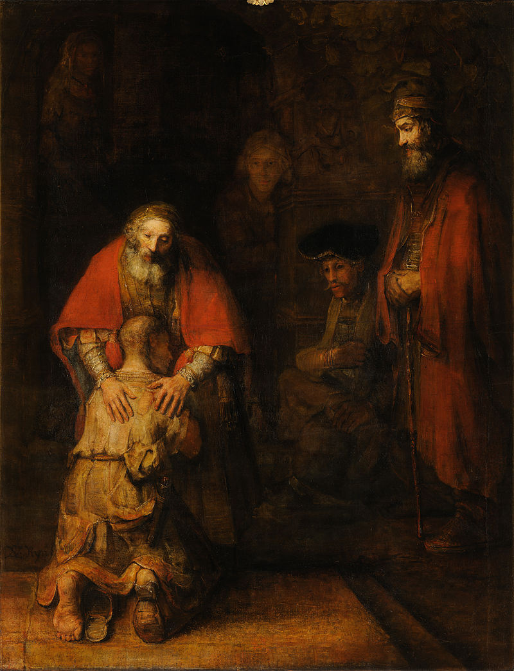
Confession: An encounter with God
As we hear in the parable of the ‘Prodigal Son’ our God is merciful (Luke 15: 11-32)
When we UNDERSTAND what we have done wrong AND are truly sorry for this
Then we can RETURN to him
Our heavenly Father WAITS for us, and when we return he WELCOMES us back.
The LOVE and MERCY of our God is infinite but we have to open the door to our souls, he will NEVER force this upon us.
Notes:
This parable from the Gospel of LUKE is worth keeping in mind if we truly wish to understand confession.
The Father respects his son’s decisions, even though they lead him away from his family. The Father is on the look out for his son, and when returns, he runs to him, does NOT admonish him. Instead he holds him close, KISSES him tenderly, CLOTHES him to restore his dignity and WELCOMES him back into the family home.
This is how confession SHOULD ALWAYS be, an encounter with the tender love and mercy of our God!

Slide 12
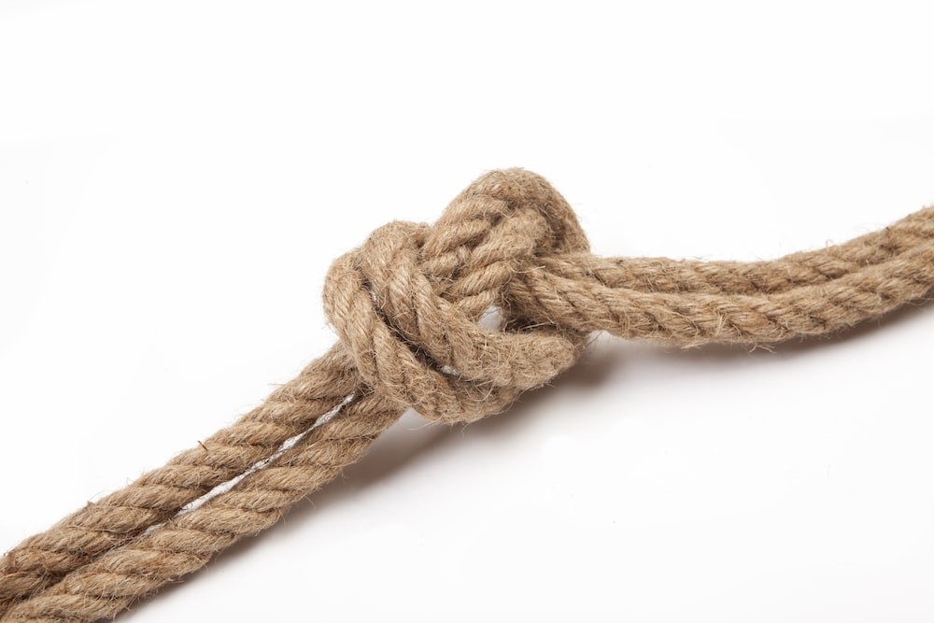
Making things right…
a PRAYER
a work of MERCY
a SACRIFICE
an act of SELF-DENIAL
Notes:
By doing this, we CO-OPERATE with God and it helps TO REPAIR/HEAL the damage done to our relationship with God an our neighbour.
This is why the priest will give a penance which is usually: A PRAYER, A WORK OF MERCY, A SACRIFICE, or AN ACT OF SELF-DENIAL.

Slide 13
The Sacramental Seal
“The sacrament seal is INVIOLABLE. Accordingly, it is ABSOULTLY WRONG for a confessor in any way to betray the penitent, for any reason whatsoever, whether by word or in any other fashion.”
Notes:
Canon Law (983 s1), the Law of the Church, makes it clear that the priest cannot for any reason break the seal of confession.
The point is that you and your children are free to express your sins to God through the priest without fear that it will be used or leaked in any way.
So much so that any knowledge we gain from confession we are forbidden from using to the detriment of the penitent (Can 984)
It is important that your children know that the priest will NOT share what they express in confession, so that they can confess with CONFIDENCE.

Slide 14
CONTRITION + CONFESSION + SATISFACTION
=
THE SACREMENT OF PENANCE
Confession by the numbers
Notes:
Contrition = we are truly sorry for our sins
Confession = we disclose what our sins to God (those things we keep hidden do weigh us down, the confessional is a place where God makes our burden lighter!)
Satisfaction = making good the wrong we have done to our neighbour.

Slide 15

Trust in his mercy
“The Lord does not wish the sinner to die but to turn back to him and live. Come before him with trust in his mercy.”
Ezekiel 33:11
Notes:
As parents you task is to help your children understand that Confession is NOT about being told off but about trusting in the MERCY of Jesus Christ.
It is about repairing the damage our sinful actions have cause both to our relationship with GOD and EACH OTHER.

Slide 16
Confession and your family
The sacrament of penance is an encounter with the LOVE and MERCY of our God.
It is NOT a place to fear because it is GOD you are going to MEET.
The priest WILL NEVER disclose what you say or use this against you.
Confession helps us MAKE THINGS RIGHT, it helps us to REPAIR the damage our SINS cause to our relationship with GOD and our NEIGHBOUR.
As parents you should lead by example which means going to Confession yourselves too.
Notes:
When was the last time you experienced the tender love and mercy of God?
If you cannot remember then it has been TOO LONG! I would encourage you to come to confession.
There is CONFESSION here on a Saturday morning 11am – 11.45am AND 5pm – 5.45pm.

Slide 17

The path to holiness…
“The Lord is compassion and love, slow to anger and rich in mercy.
For as the heavens are high above the earth so strong is his love for those who fear him.
As far as the east is from the west so far does he remove our sins.”
Psalm 103: 8; 11-12
Notes:
The path to holiness is not always easy, it is long and winding, we can get lost very easily.
Confession helps us deal with those difficulties and to keep going.
Confession is an essential part of any Catholic’s life and it is important to encourage your family to make use of this wonderful SACRAMENT, this channel of GOD’S GRACE.
God wants to forgive us our sins, he wants us to return to him.
We have to WANT to go back to him, this requires HUMILTY; COURAGE and STRENGTH but I promise you all, if you and your family make good use of this sacrament, if keep topping up you lives with GOD GRACE then there will be NO CHALLENGES that you cannot face.

Slide 18
Any questions?

Slide 19
Mortal and Venial Sins
Mortal Sin
Venial Sin
DESTROYS charity in the heart by a grave violation of God’s law, it TURNS us away from God…towards an INFERIOR GOOD
There are THREE ingredients in a mortal sin:
  GRAVE matter
  FULL knowledge
  DELIBERATE consent
Catechism 1857
Allows charity to subsist, even though it OFFENDS and WOUNDS it.
It prevents the soul’s exercise of the virtues and the practice of the moral good
Deliberate and unrepented venial sin will lead us to mortal sin.
Catechism 1863
Notes:
This distinction is useful helps understand the nature of our sins.
Mortal Sin
Grave matter = the TEN COMMANMENTS
Need to KNOW what you are doing is wrong AND sinful
You must WILLINGLY consent.
ALL three conditions HAVE to be met for it to be a mortal sin.
Venial Sin
Concerns less serious matter (CCC 1862)
You don’t observe the standard prescribed by moral law.
It DOES NOT set us in direct opposition to the will and friendship of God
It does not break our promises with God.
However, over time, deliberate and unrepented venial sin will lead us into mortal sin.

