Slide 1

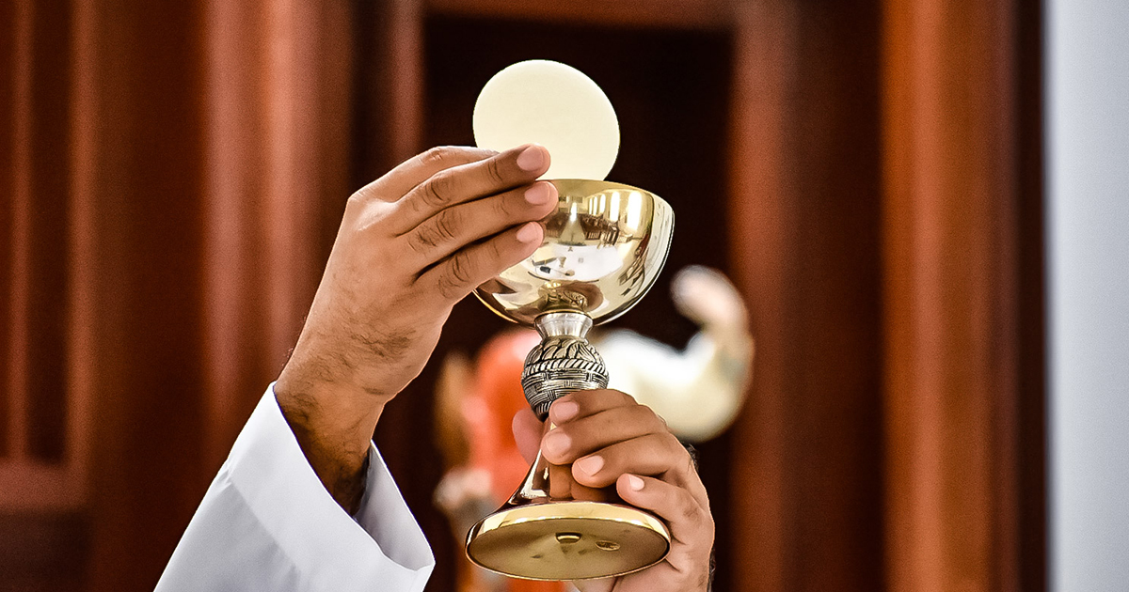
FHC Parents Session 3:
The Eucharist
Fr Daniel Daley
Notes:
Welcome to this final Parent’s session on the Eucharist.

Slide 2
Prayer
O Lord, Jesus Christ, King of everlasting glory, behold I desire to come to you this day, and to receive your Body and Blood in this heavenly Sacrament, for your honour and glory, and the good of my soul. I desire to receive you, because it is your desire, and you have so willed it: blessed be your Name forever.
I desire to come to you like Magdalen, that I may be delivered from all my evils, and embrace you, my only Good. I desire to come to you, that I may be happily united to you, that I may henceforth abide in you, and you in me; and that nothing in life or death may ever separate me from you. Amen.
Notes:
Preparation prayer for Holy Communion, from page 22 of the Manual of Prayers.

Slide 3
Eucharist, Sign, symbol or The body of Christ?
Notes:
This is the central theme of all of this session, what do we believe? What or who are receiving when we receive the Eucharist? How do we explain this to our children?

Slide 4
What does Jesus say about it?
“Truly, truly, I say to you, he who believes has eternal life. I AM THE BREAD OF LIFE” John 6: 47 – 48
“I am the living bread which came down from heaven; if any one eats of this bread, he will live for ever; and the bread which I shall give for the life of the world is MY FLESH.” John 6: 50 – 51
“Truly, truly, I say to you, unless you eat the flesh of the Son of man and drink his blood, you have no life in you, he who eats my flesh and drinks my blood has ETERNAL LIFE, and I will raise him up at the last day.” John 6: 53 – 54
“For my flesh is food indeed, and my blood is drink indeed.” John 6: 55
Notes:
John 6:51-56 Jesus promised to give food from heaven that would be his flesh and blood.
He fulfilled this promise at the LAST SUPPER, when he took the bread and said explicitly “this is MY body” and when he took the wine and said “this is the chalice of MY BLOOD.”
This gift is also made present to us today. When the priest speaks the words of consecration in the Mass, the bread and wine truly become the body and blood of Jesus Christ.
The Church calls this change TRANSUBSTANIATION because the substance of bread and wine are really changed, becoming the substance of Jesus Christ himself.
For this reason, uniquely of all things present to our senses in this world, we worship the Eucharist as God.

Slide 5
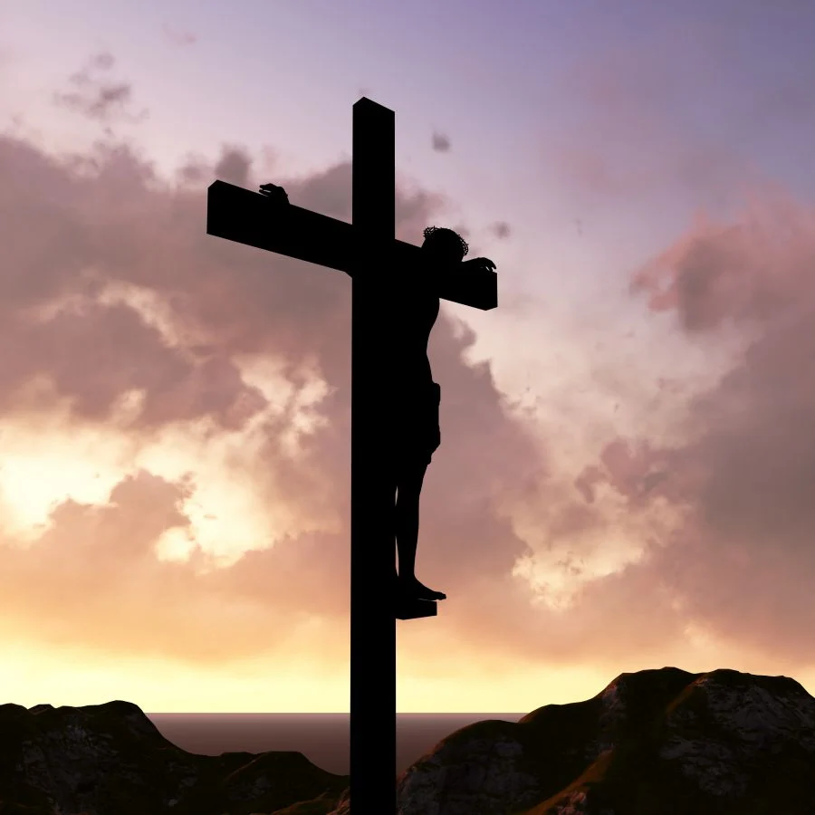
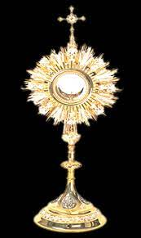
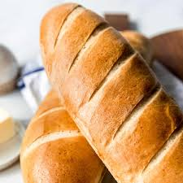
What is the Eucharist?
Sacrifice
Presence
Food
Notes:
There are 3 essential elements of the Eucharist.
SACRIFICE – participation in the sacrifice of the cross – ‘this is my body broken for you’
PRESENCE – when we receive, the minister says to us ‘the body of Christ’ and we respond AMEN – YES IT IS!
FOOD – sustaining us, helping us grow and become holy.

Slide 6
The Eucharist as Food
Union
Strength
Promise
By consuming his life we become like him, and he DWELLS within us.
For this reason the Eucharist is also called Holy Communion.
As a meal, it also expresses intimacy with Christ and unity with the whole Church.
By consuming divine food, we gain nourishment in the divine life that Christ has shared with us.
The form of BREAD under which it appears is a sign that the Eucharist gives us strength for the spiritual journey through life, and at the approach of death.
By receiving the risen Jesus, we also receive in the Eucharist the POWER of his Resurrection within us.
As he promised, “He who eats my flesh and drinks my blood has eternal life, and I will raise him up at the last day.” John 6:56 and 6:40.
Notes:
You are what you eat! It is not just a good excuse to get your children to eat their vegetables, it is literally true of the Eucharist!
We receive Jesus’ body in the form of bread because he knows our limits, flesh is too much for us, he wished to come to us in a form that we could accept and consume. That is a testament to love, care and thought Jesus has for us.
The children seem to understand this principle very well, but some struggled with the idea of food that is passed out of the body. A legitimate thought but St Francis makes it clear that with the Holy Eucharist, as it is the BODY OF CHRIST it is ALL absorbed, as we become more like Christ, NOTHING is wasted.

Slide 7
Sacrifices in the Old Testament
Sacrifices offer something up to God to honour him, to thank him, to gain communion with him and make amends for ones sins.
Many examples of sacrifices in the Old Testament, the most famous of these is the sacrifice of PASSOVER, where shedding the blood of the Paschal LAMB and eating its FLESH marked the ‘passing over’ from sin and death to freedom and life.
These imperfect sacrifices of fallen humanity could never achieve our redemption or unite us to God.
Notes:
Melchizedek’s offering of bread and wine (unbloody)
Abraham's offering of the ram in place of his son Isaac (bloody)

Slide 8
The sacrifice of Christ
When Jesus begins his mission, John the Baptist calls him, “the LAMB of God, who takes away the sin of the world.”
By these words John reveals that Jesus is the perfect sacrifice prefigured by the Old Testament sacrifices.
At the Passover meal (the LAST SUPPER) he shared with his disciples Jesus takes the bread and wine and offers up his imminent death for our salvation.
Notes:
Christ’s offering on Calvary and its salvific effects are made present to all ages until the end of time.

Slide 9
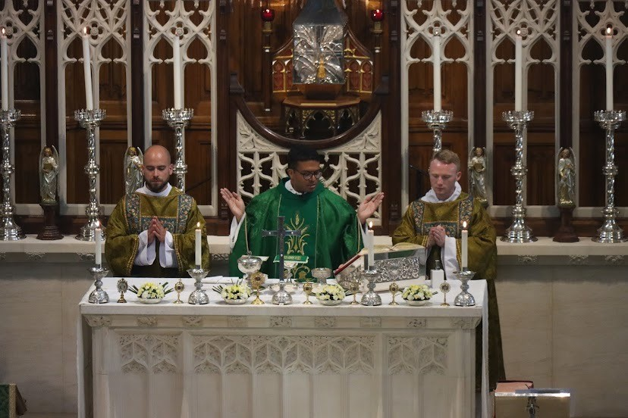
This Eucharistic sacrifice is called:
THE MASS
The Church through her priests, continues to offer the SAME Eucharist sacrifice as Jesus.
This is why at every Mass the words institution are ALWAYS in the present tense:
“Take this, all of you and eat of it, for this is my Body, which will be given up for you.”
“Take this, all of you, and drink from it, for this is the chalice of my Blood, the Blood of the new and eternal covenant, which will be poured out for you and for many for the forgiveness of sins. Do this in memory of me.”
Notes:
It is the CENTRE of the Church’s worship, and so is right knows as “the source and summit of the Christian life.” LG 11
This is also why as beneficial as live streamed Mass, especially for the sick and the housebound, there is no real substitute for being present AT MASS!
At every Mass when the priest invokes the Holy Spirit, we witness a miracle as the BREAD and WINE on the altar become the BODY and BLOOD of Jesus Christ.

Slide 10
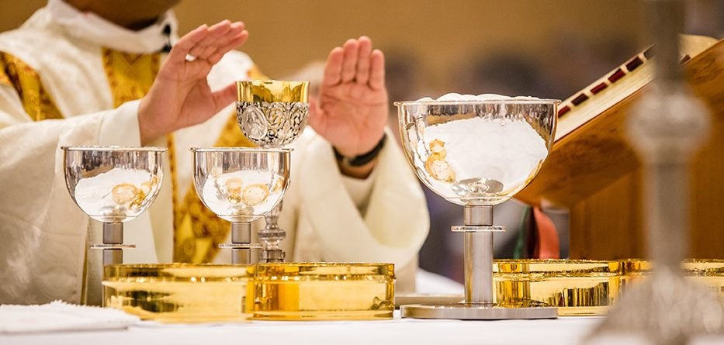
transubstantiation
Jesus promised to give us food from heaven.
This gift is also made present to us today. When the priest speaks the words of CONSECRATION (Latin = to make holy) in the Mass.
The Church calls this change TRANSUBSTANIATION because the substance of bread and wine are CHANGED by the HOLY SPIRIT into Jesus Christ himself.
Thus, at every Mass we witness a MIRACLE as the BREAD and WINE on the altar become the BODY and BLOOD of Jesus Christ.
Notes:
For this reason, uniquely of all things present to our senses in this world, we worship the Eucharist as God

Slide 11
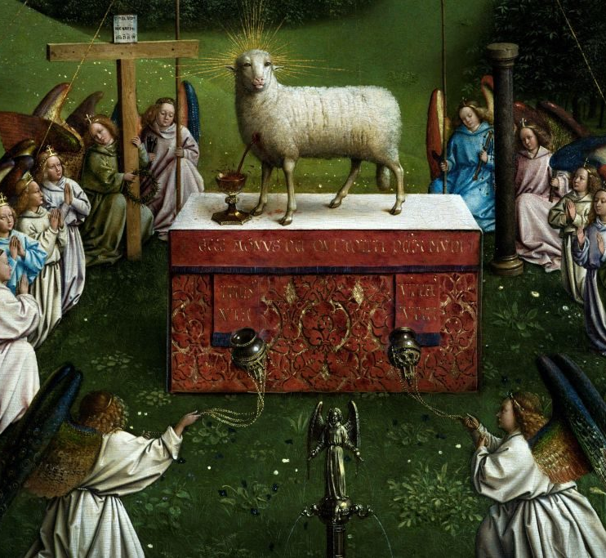
Importance of the Mass
The Mass as a sacred banquet on earth is also our sharing something far greater in heaven.
Scripture refers to a heavenly wedding feast, “Blessed are those who are called to the Marriage Feast of the Lamb.” Rev 19:9
Notes:
[STORY – if Jesus is my friend where can I see him??? – THE MASS!]
So, your children’s FIRST holy communion should not be their last!
It is important as will nourishment that we keep on receiving it.
The Sunday obligation has been re-instated but when we truly understand what THE MASS is, when we appreciate the wonder of the what we receive in HOLY COMMUNION, then it is no longer a chore, it is part of our journey towards holiness, part of us become like Christ.

Slide 12
Be prepared…
“For as often as you eat this bread and drink the cup, you proclaim the Lord's death until he comes. Whoever, therefore eats the bread or drinks the cup of the Lord in an unworthy manner will be guilty of profaning the body and blood of the Lord.”
1 Corinthians 11:26-27
Notes:
1 Corinthians 11:26-27
St Paul’s warning to us here reminds us that we should be in a state of grace when we receive.
This why alongside preparing to receive the Eucharist your children also prepare to make their first CONFESSION / RECONCILIATION.
The Eucharist is also reserved/meant for PRACTICING CATHOLICS – so those from other Christian denominations CANNOT receive the body of Christ unless their particular Church is recognised as being in communion with Rome.
I say this because I am aware that some, not all, Anglican ministers have wrongly said their flock can receive in a Catholic Church. This is not so. They can still come forward for a blessing but not to receive.

Slide 13
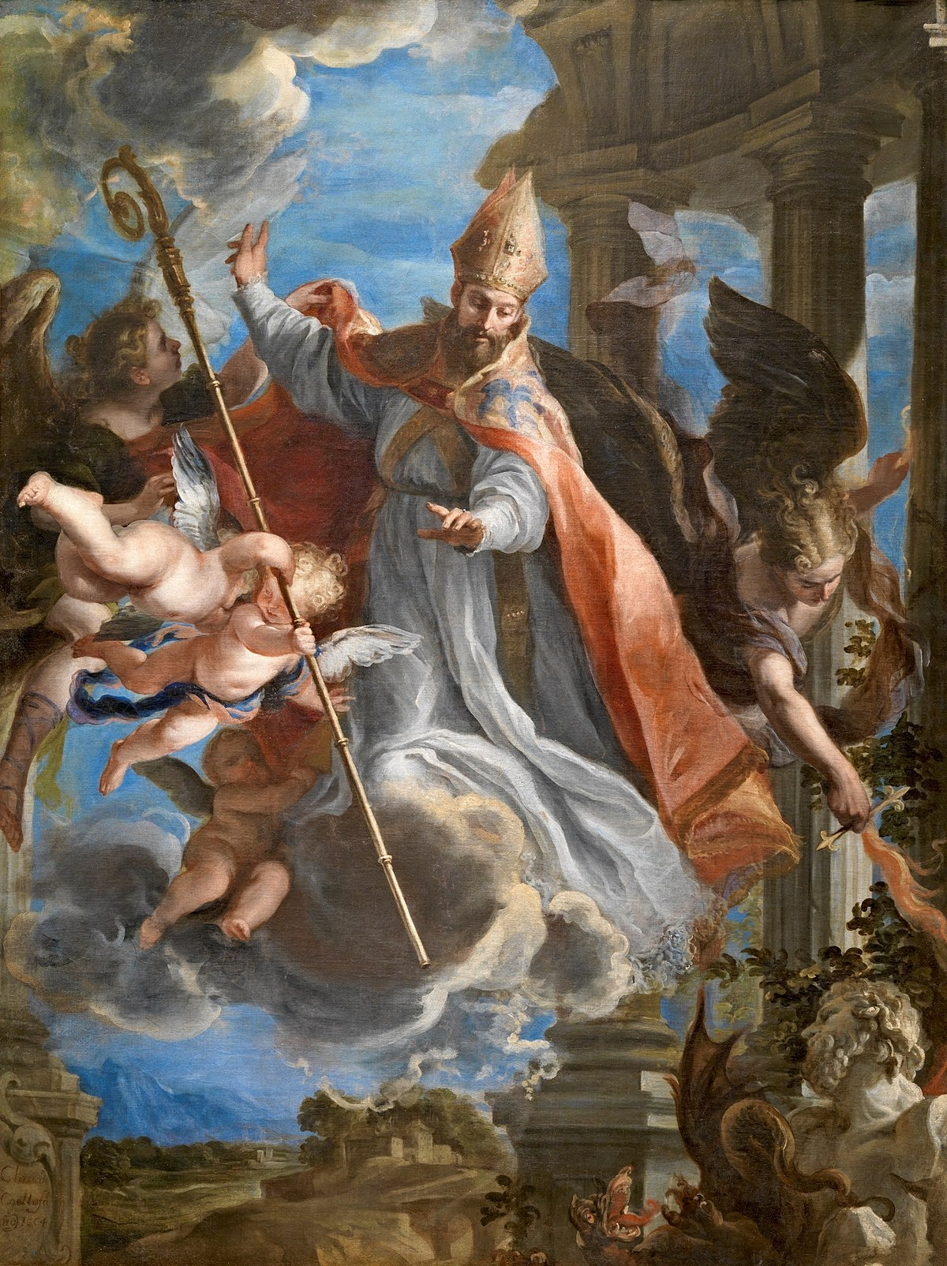
The saints on the Eucharist
“Behold what you are, become what you consume”
St Augustine of Hippo
Notes:
St Augustine invites us to “behold what we are and become what we consume.”
We are what eat!
This is why our understanding of the Eucharist is CENTRAL to our faith. If we do not believe that the Eucharist is the body of Christ, then we might as well go home!
However, if we believe that the Eucharist is the body of Christ, not only does the our God become present in our life, this magnificent sacrament is also helping to transform us into SAINTS, HOLY MEN AND WOMEN.

Slide 14
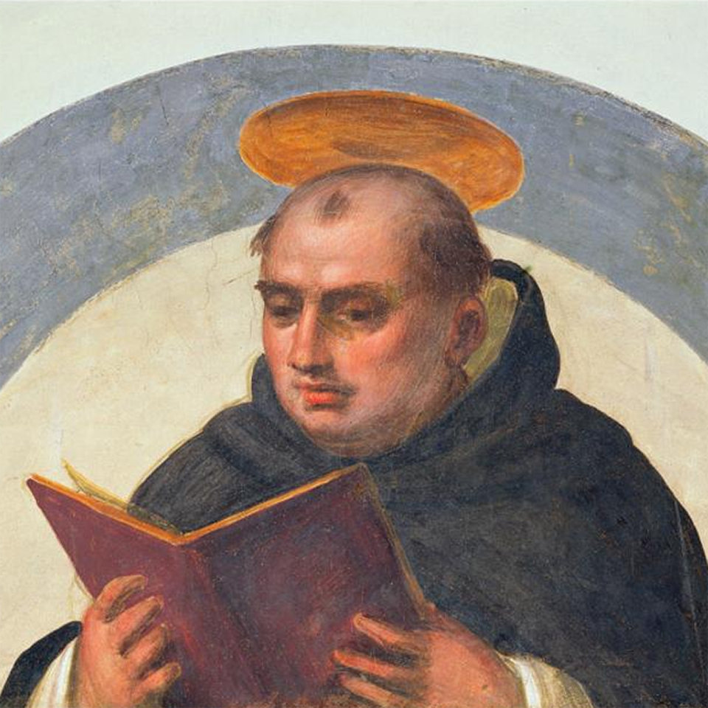
“The actual effect of the eucharist is the transformation of man into god.”
St Thomas Aquinas
Notes:
The celebration of the EUCHARIST is the heart of the Christian communion.
We are not the Church because we get along well (although that certainly helps!), or because we happen to end up in the same parish community.
WE ARE THE CHURCH because we receive the BODY OF CHRIST and are increasingly TRANSFORMED INTO THE BODY OF CHRIST.

Slide 15
St John Vianney
“God would have given us something greater if he had had something greater than himself.”

Slide 16
The Seven Sacraments
Baptism
The gateway into the faith; joins us with Christ
Confirmation
Gives us his Spirit
Eucharist
Unites us with Jesus
Confession / Anointing
Marriage / Holy Orders
Sacraments of communion & mission
Healing of both soul & body
Sacraments of Initiation
Like Confession and Holy Anointing, the Eucharist is a Sacrament we can receive repeatedly, more than once - so we have continuous access to God’s grace!
Notes:
All sacraments are channels of God’s grace, an encounter with Christ, who is himself the original sacrament.
The EUCHARIST is unique because it is both a sacrament (an encounter with Jesus) and also a SACRIFICE (the sacrifice of Christ himself).
Like Confession and Holy Anointing, the Eucharist is a Sacrament we can receive repeatedly, more than once - so we have continuous access to God’s grace!

Slide 17
This is my body…
As Catholics we believe in the REAL PRESENCE of Jesus in the Eucharist.
Holy Communion is the GIFT of God himself to us!
“God never gives less than himself.” St Augustine of Hippo.
Which is why it is called the EUCHARIST (Greek = Thanksgiving)!
Our God is NOT distant from our lives, he is with us, in the midst of it all, most especially in the Eucharist!

Slide 18
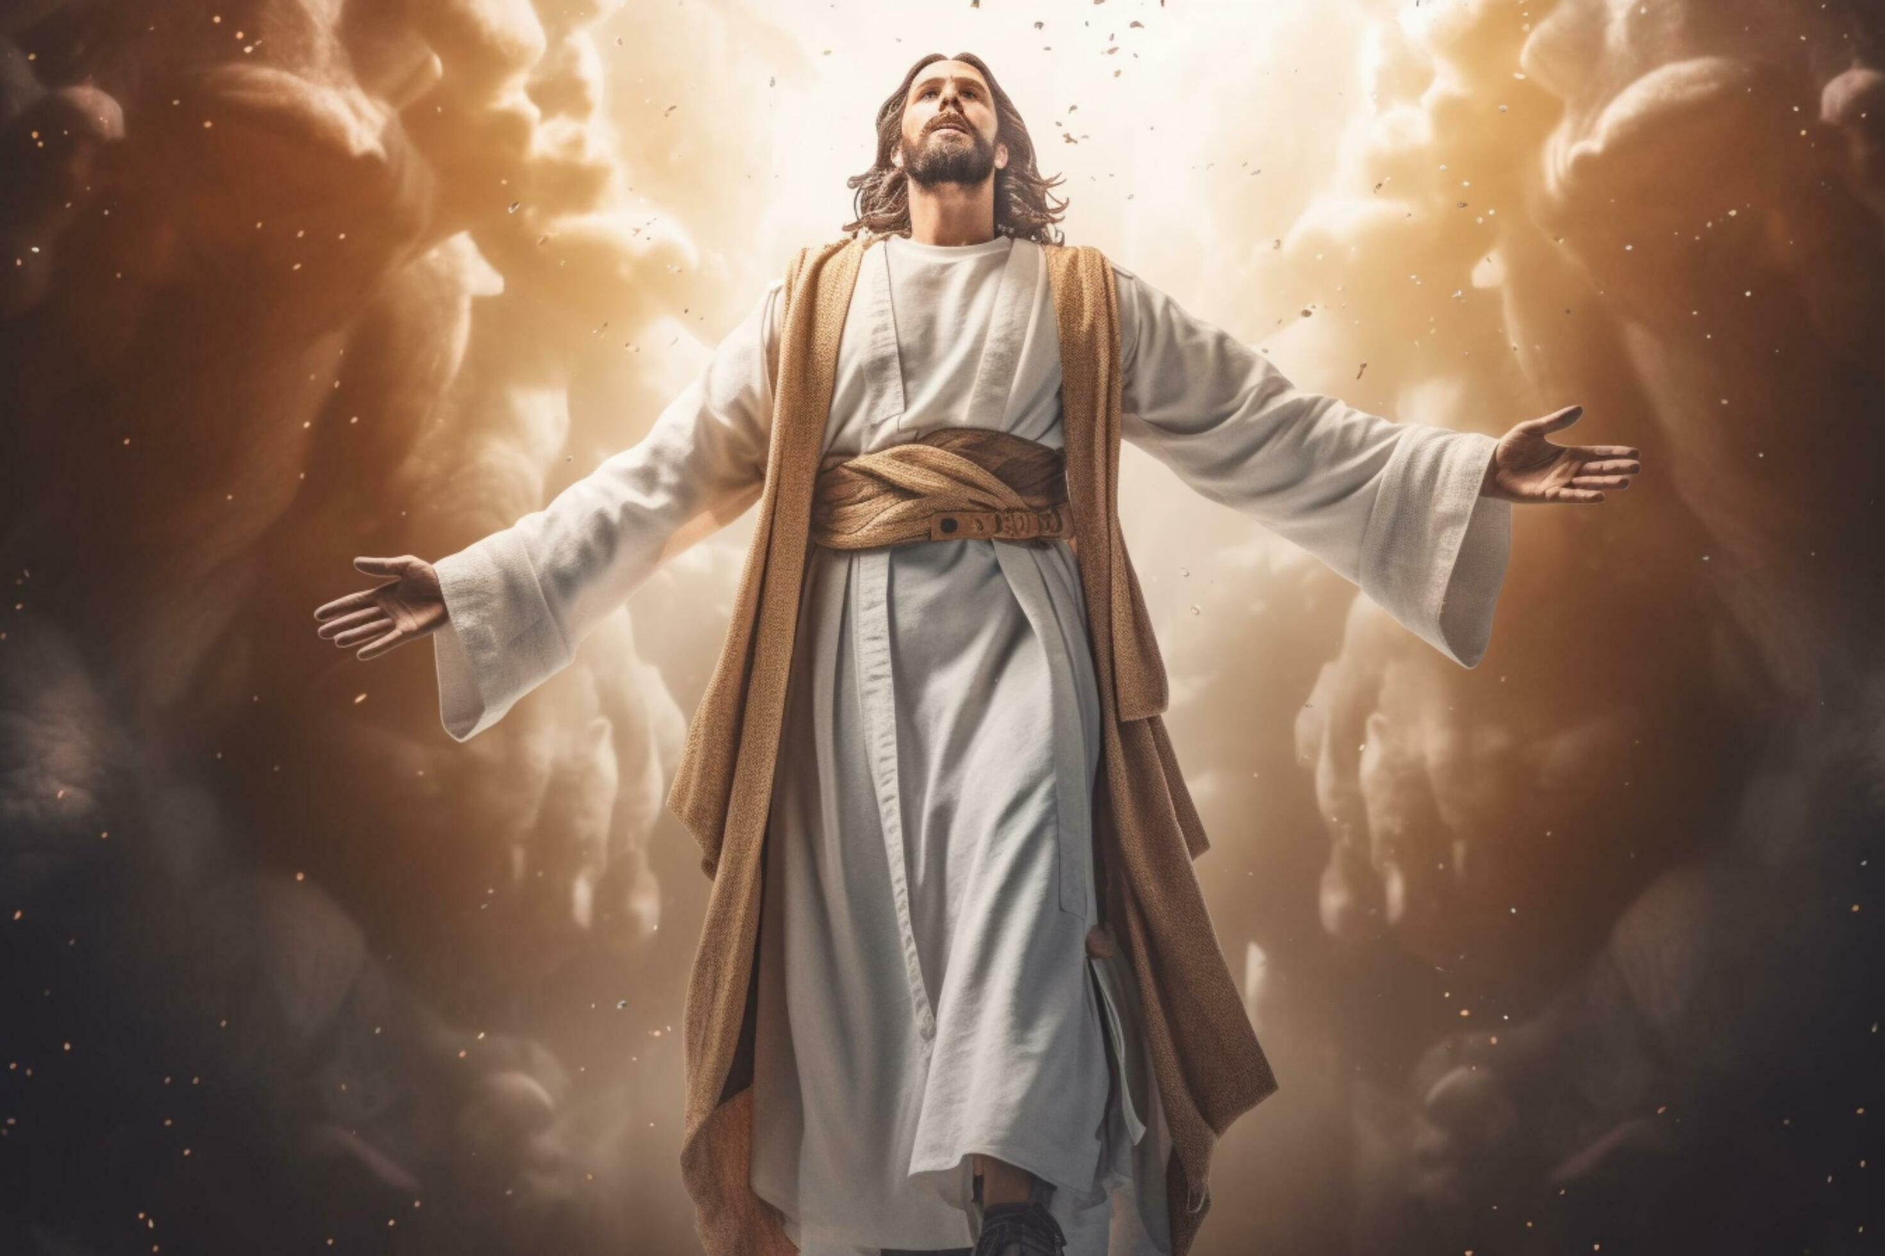
The Eucharist is Christ himself, helping you and your children become the saints he made you all to be!
Notes:
A Final thought…

Slide 19
Any questions?

